Slide 1
International Climate Policy
Game theory
International cooperation
Cartel formation
International negotiations
From Rio via Kyoto and Copenhagen to Paris
Acid rain and the hole in the ozone layer

Slide 2
Lectures
Science
Scenarios & emission reduction options
Costs of emission reduction
Instruments for emission reduction
Impacts of climate change & adaptation
Economic impacts of climate change
Climate and development
Optimal emission reduction
Discounting, uncertainty, equity
International environmental agreements

Slide 3
International Climate Policy
Game theory
International cooperation
Cartel formation
International negotiations
From Rio via Kyoto and Copenhagen to Paris
Acid rain and the hole in the ozone layer

Slide 4
Optimal Climate Policy
In a static optimum, the marginal costs should equal the marginal benefits
In a situation like climate change, where the benefits are a stock and the costs are a flow, the marginal costs should equal the net present value of the marginal benefits

Slide 8

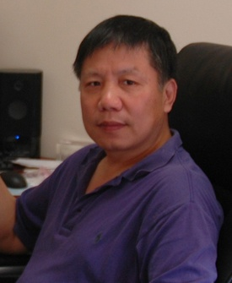

Slide 9
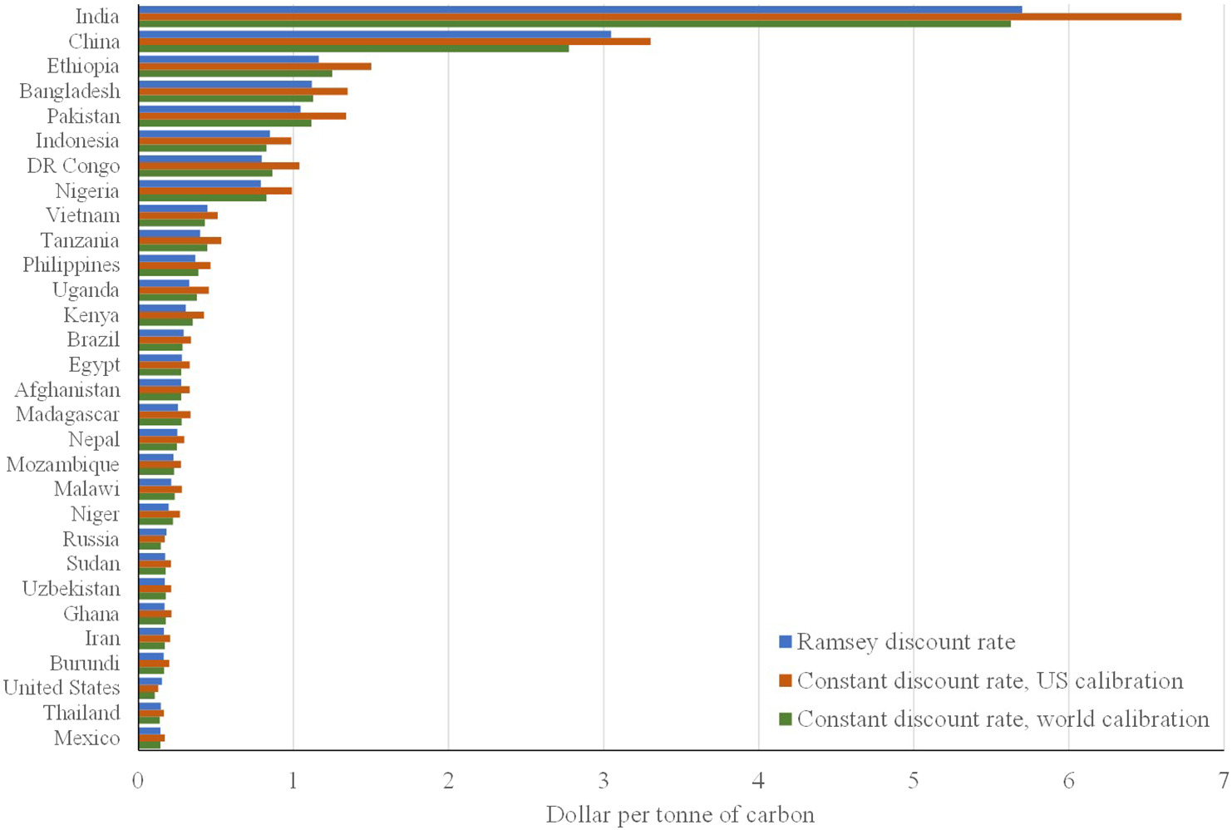
Global $24/tC
$28/tC
$24/tC

Slide 11
Cooperation v non-cooperation
Assume that the national costs of greenhouse gas emission reduction are primarily determined by the national emission reduction effort
In a cooperative optimum, the national marginal costs of emission reduction equal the global marginal benefits
In a non-cooperative optimum, the national marginal costs of emission reduction equal the national marginal benefits
Cooperative action is more ambitious
Can cooperation be sustained?

Slide 12

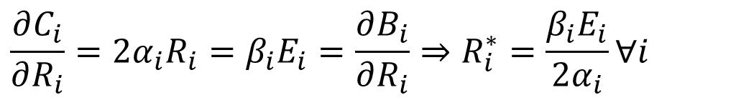

Free Riding
Costs of emission reduction for country i
Benefits of emission reduction
The non-cooperative solution is
$$C_{i}=α_{i}R_{i}^{2}$$
$$B_{i}=β_{i}\left(\sum_{j}{R_{j}E_{j}}\right)$$
$$\frac{∂C_{i}}{∂R_{i}}=2α_{i}R_{i}=β_{i}E_{i}=\frac{∂B_{i}}{∂R_{i}}⇒R_{i}^{∗}=\frac{β_{i}E_{i}}{2α_{i}}∀i$$

Slide 13
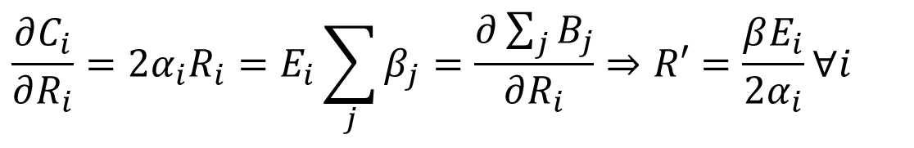
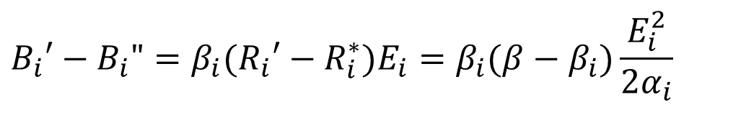
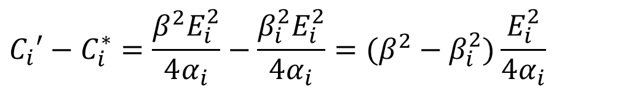
Free Riding -2
The cooperative solution is
The difference in costs is
The difference in benefits if free-riding is
$$\frac{∂C_{i}}{∂R_{i}}=2α_{i}R_{i}=E_{i}\sum_{j}{β_{j}}=\frac{∂\sum_{j}{B_{j}}}{∂R_{i}}⇒R′=\frac{βE_{i}}{2α_{i}}∀i$$
$$C_{i}′−C_{i}^{∗}=\frac{β^{2}E_{i}^{2}}{4α_{i}}−\frac{β_{i}^{2}E_{i}^{2}}{4α_{i}}=(β^{2}−β_{i}^{2})\frac{E_{i}^{2}}{4α_{i}}$$
$$B_{i}′−B_{i}"=β_{i}(R_{i}′−R_{i}^{∗})E_{i}=β_{i}(β−β_{i})\frac{E_{i}^{2}}{2α_{i}}$$

Slide 14
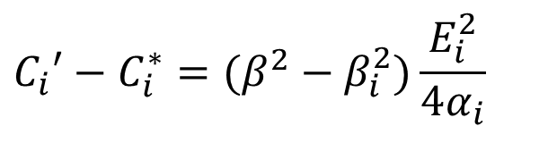
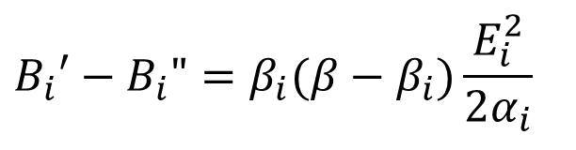
Free Riding -3
The difference in costs is
The difference in benefits is
$$C_{i}′−C_{i}^{∗}=(β^{2}−β_{i}^{2})\frac{E_{i}^{2}}{4α_{i}}$$
$$B_{i}′−B_{i}"=β_{i}(β−β_{i})\frac{E_{i}^{2}}{2α_{i}}$$

Slide 15
Free Riding -3
The difference in costs is
The difference in benefits is
$$C_{i}′−C_{i}^{∗}=(β^{2}−β_{i}^{2})\frac{E_{i}^{2}}{4α_{i}}$$
$$B_{i}′−B_{i}"=β_{i}(β−β_{i})\frac{E_{i}^{2}}{2α_{i}}$$

Slide 16
Free Riding -3
The difference in costs is
The difference in benefits is
$$C_{i}′−C_{i}^{∗}=(β^{2}−β_{i}^{2})\frac{E_{i}^{2}}{4α_{i}}$$
$$B_{i}′−B_{i}"=β_{i}(β−β_{i})\frac{E_{i}^{2}}{2α_{i}}$$

Slide 17
International Climate Policy
Game theory
International cooperation
Cartel formation
International negotiations
From Rio via Kyoto and Copenhagen to Paris
Acid rain and the hole in the ozone layer

Slide 18
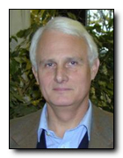
Cartel Theory
A coalition is said to be stable iff
It is profitable, that is, the coalition members have a higher welfare than in the Nash equilibrium
It is internally stable, that is, no coalition member is better off by leaving
It is externally stable, that is, no non-coalition member is better off by joining
The grand coalition is externally stable
A profitable coalition of two players is internally stable

Slide 19
Cartel Theory -2
Essentially, if a player joins a coalition, then she should decrease her emissions further, because she now also has to take into account the impact of her emissions on other players
In return, the other coalition members further reduce their emissions – is this welfare improving or not? And does it reduce emissions?

Slide 20

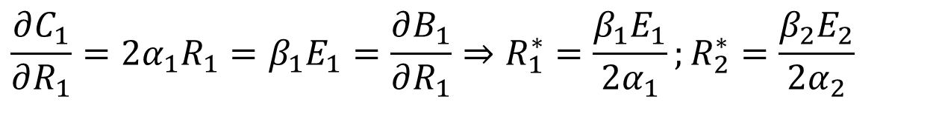
Coalition formation
Costs of emission reduction
Benefits of emission reduction
The non-cooperative solution is
$$C_{1}=α_{1}R_{1}^{2};C_{2}=α_{2}R_{2}^{2}$$
$$B_{1}=β_{1}\left(R_{1}E_{1}+R_{2}E_{2}\right);B_{2}=β_{2}\left(R_{1}E_{1}+R_{2}E_{2}\right)$$
$$\frac{∂C_{1}}{∂R_{1}}=2α_{1}R_{1}=β_{1}E_{1}=\frac{∂B_{1}}{∂R_{1}}⇒R_{1}^{∗}=\frac{β_{1}E_{1}}{2α_{1}};R_{2}^{∗}=\frac{β_{2}E_{2}}{2α_{2}}$$

Slide 21
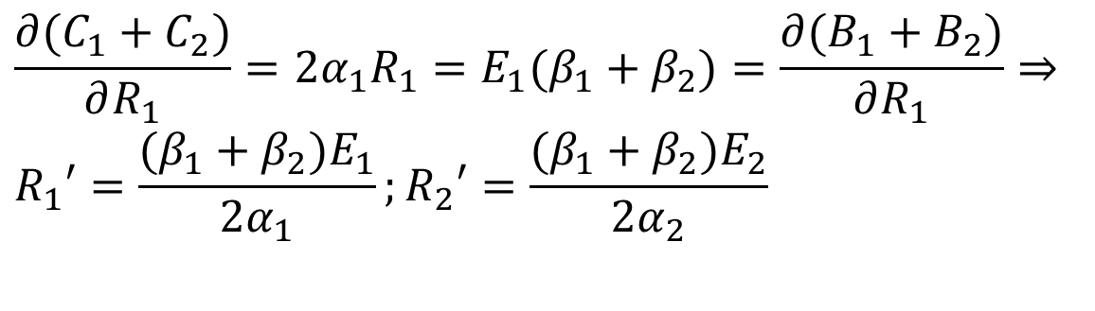
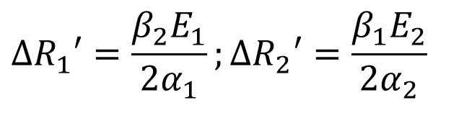
Coalition formation -2
The cooperative solution is
So, player 1 increases its emission reduction, and gets increased emission reduction by the other player in return:
$$\frac{∂(C_{1}+C_{2})}{∂R_{1}}=2α_{1}R_{1}=E_{1}(β_{1}+β_{2})=\frac{∂(B_{1}+B_{2})}{∂R_{1}}⇒ \\ R_{1}′=\frac{(β_{1}+β_{2})E_{1}}{2α_{1}};R_{2}′=\frac{(β_{1}+β_{2})E_{2}}{2α_{2}}$$
$$ΔR_{1}′=\frac{β_{2}E_{1}}{2α_{1}};ΔR_{2}′=\frac{β_{1}E_{2}}{2α_{2}}$$

Slide 22
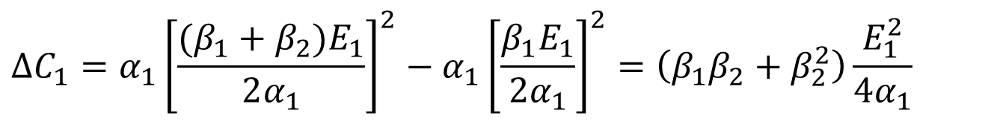
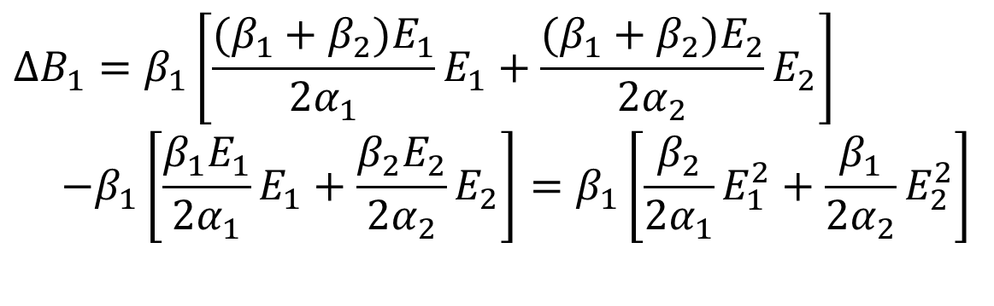
Coalition formation -3
Difference in costs
Difference in benefits
$$ΔC_{1}=α_{1}{\left[\frac{(β_{1}+β_{2})E_{1}}{2α_{1}}\right]}^{2}−α_{1}{\left[\frac{β_{1}E_{1}}{2α_{1}}\right]}^{2}=\left(β_{1}β_{2}+β_{2}^{2}\right)\frac{E_{1}^{2}}{4α_{1}}$$
$$ΔB_{1}=β_{1}\left[\frac{(β_{1}+β_{2})E_{1}}{2α_{1}}E_{1}+\frac{(β_{1}+β_{2})E_{2}}{2α_{2}}E_{2}\right] \\ −β_{1}\left[\frac{β_{1}E_{1}}{2α_{1}}E_{1}+\frac{β_{2}E_{2}}{2α_{2}}E_{2}\right]=β_{1}\left[\frac{β_{2}}{2α_{1}}E_{1}^{2}+\frac{β_{1}}{2α_{2}}E_{2}^{2}\right]$$

Slide 23
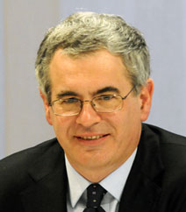


Coalition formation-4
$$ΔC_{1}<ΔB_{1}∧ΔC_{2}<ΔB_{2}$$
Coalition if
That is, you want to promise a small extra reduction of your emissions, and get a big reduction of the other’s emissions in return
But, the other player expects the same
Coalition formation is barter trade – but without production, welfare gains are small
Costs are more than linear, benefits are linear, so changes in emissions are small too
Either coalition is small, or emission reduction is small

Slide 24
International Climate Policy
Game theory
International cooperation
Cartel formation
International negotiations
From Rio via Kyoto and Copenhagen to Paris
Acid rain and the hole in the ozone layer

Slide 25
International Climate Policy
International climate policy has a long history of good intentions

Slide 26
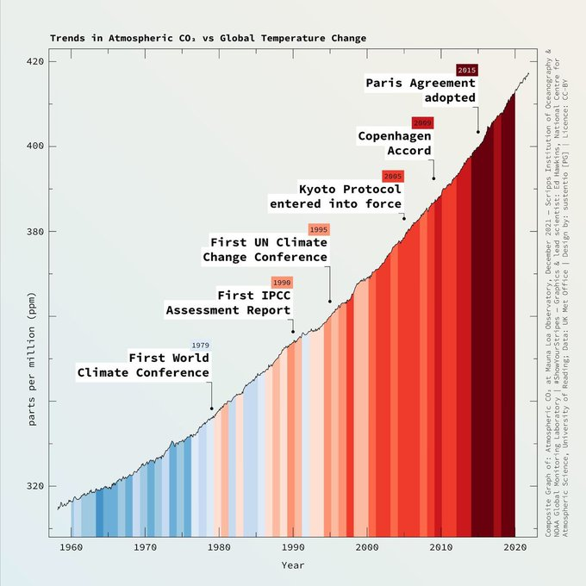

Slide 27
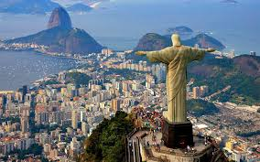
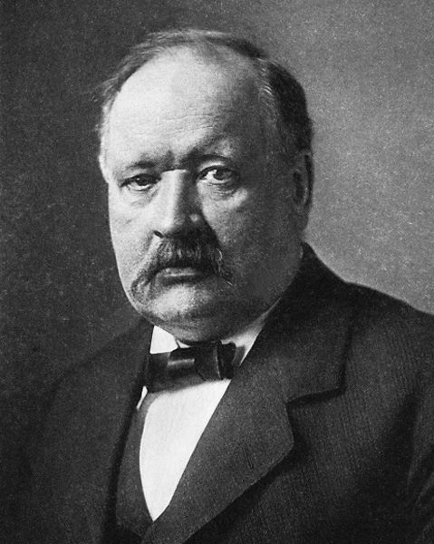
International Climate Policy
International climate policy has a long history of good intentions
Climate change has been on the scientific agenda since 1896, but global warming started booming in the early 1980s
Politicians started paying attention in the late 1980s, and climate change was a major topic on the United Nations Conference on Environment and Development, Rio de Janeiro, 1992
There, the UN Framework Convention on Climate Change (UNFCCC) was negotiated

Slide 28
Intl. Climate Policy -2
The FCCC is ratified by almost all countries
The FCCC is a framework convention, that is, it sets the rules for later negotiations but does not establish policy targets itself
Except for two.
First, the FCCC acknowledges the „common but differentiated responsibilities“ of countries, that is, this is global problem that is of OECD making, so the OECD should take the lead in solving it
Second, concentrations should be stabilized ...

Slide 29
Intl. Climate Policy -3
The ultimate objective of [the United Nations Framework Convention on Climate Change] [...] is to achieve [...] stabilization of greenhouse gas concentrations in the atmosphere at a level that would prevent dangerous anthropogenic interference with the climate system. Such a level should be achieved within a time-frame sufficient to allow ecosystems to adapt naturally, to ensure that food production is not threatened and to enable economic development to proceed in a sustainable manner.

Slide 30
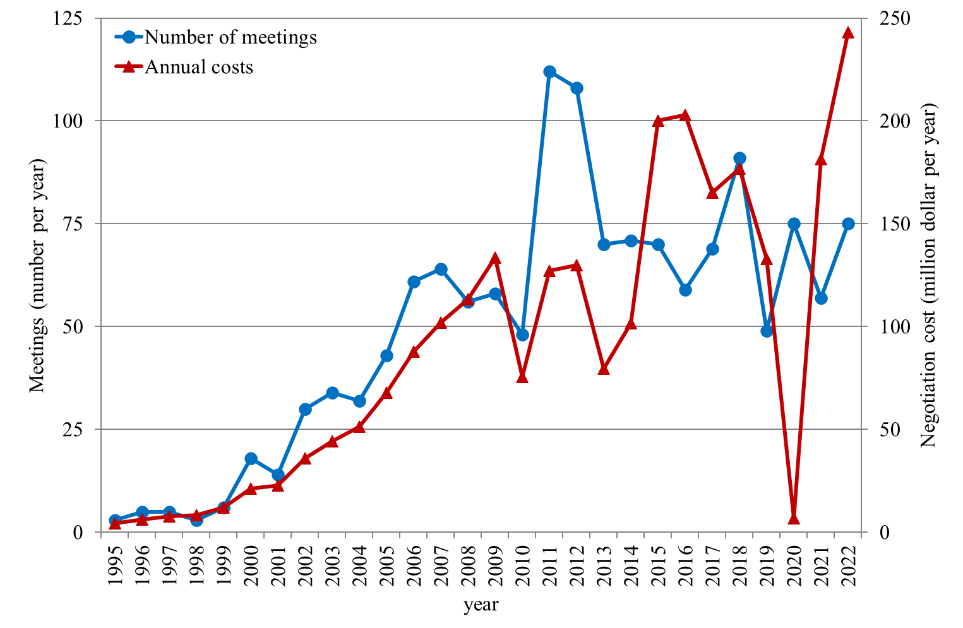
UNFCCC started a series of negotiations

Slide 31


Intl. Climate Policy -4
The FCCC started a series of negotiations
In 1995, in Berlin, there was almost an agreement
In 1997, in Kyoto, there was one
The Kyoto Protocol specifies
Emission reduction targets
International policy instruments
Unfortunately, the Kyoto Protocol does not specify
How to define and measure emissions
To what extent instruments may be used
What happens if targets are violated

Slide 32
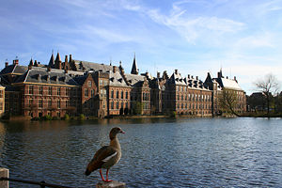

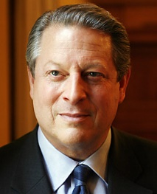



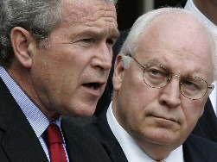
Intl. Climate Policy -5
In The Hague, there could have been an agreement, but the Europeans were too busy fighting each other
Since then, EU position is pre-negotiated and pre-announced
US government changed
Finally, in Marrakech agreement was reached on measurement of sinks (generous), on instruments (generous) and on enforcement (none), while targets were relaxed

Slide 33
Intl. Climate Policy -5
Since then, there have been more conferences, which were about fine-tuning
The EU offered greater bribes to Russia, and the Kyoto Protocol entered into force in February 2005

Slide 34
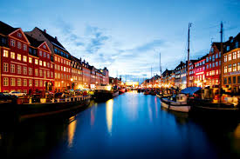
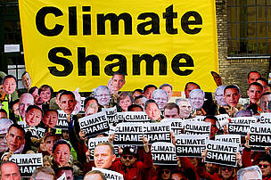


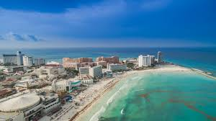
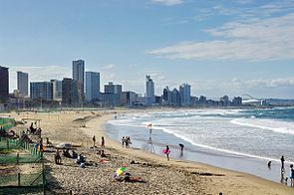
Intl. Climate Policy -6
The Kyoto targets are for 2008-12
The Kyoto Protocol did not expire: International flexibility mechanisms remain
Agreement in Bali in 2007 to negotiate new targets in 2009
Expectations were high in Copenhagen in 2009, and the backlash furious
Agreement in Cancun in 2010 to keep trying
Agreement in Durban in 2011 and Doha in 2012 to reach an agreement by 2015

Slide 35
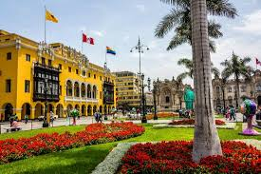
Intl. Climate Policy -7
The 2014 negotiations in Lima saw a change in tone: Intended Nationally Determined Contributions
Pledge and review is an alternative to legally binding targets, which are hard to agree on (free riding)
Tried and tested: Peace-keeping, pandemic risk
A rational actor, uncertain about the appropriate target, would offer little if there is a risk that the targets become binding
Pledge and review allows more honest bids

Slide 36

Intl. Climate Policy -10
Paris 2015 set tough targets
2.0K or perhaps 1.5K
At the same time, there are no national targets: Countries are obliged to do whatever they want, although climate policy is supposed to intensify
Developing countries thus lost their leverage, and Paris 2015 is the first COP at which no additional funding was pledged
A loss & damage mechanism was agreed at Sharm el-Sheikh 2022, but without liability and without funds
Glasgow 2021 saw shift towards emissions targets

Slide 37
Paris Agreement
4.2 Each Party shall prepare, communicate and maintain successive nationally determined contributions that it intends to achieve. Parties shall pursue domestic mitigation measure with the aim of achieving the objectives of such contributions.
4.3 Each Party’s successive nationally determined contribution will represent a progression beyond the Party’s then current nationally determined contribution […].
4.11 A Party may at any time adjust its existing nationally determined contribution with a view to enhancing its level of ambition […].

Slide 38
Paris Agreement
14.3 The outcome of the global stocktake shall inform Parties in updating and enhancing, in a national determined manner, their actions […].
15.1/2 […] compliance […] in a manner that is transparent, non-adversarial and non-punitive […]
28.1 […] Party may withdraw from this agreement

Slide 39
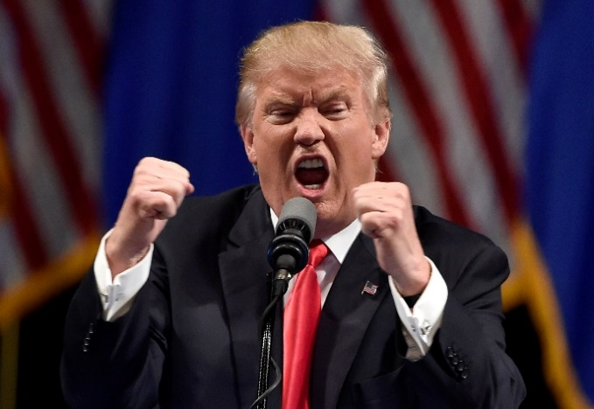
Paris Agreement
14.3 The outcome of the global stocktake shall inform Parties in updating and enhancing, in a national determined manner, their actions […].
15.1/2 […] compliance […] in a manner that is transparent, non-adversarial and non-punitive […]
28.1 […] Party may withdraw from this agreement
And that’s what Trump did, effective the day after the presidential election; Biden reversed course

Slide 40
Theory and practice
Game theory predicts that it will be hard to negotiate an international treaty on greenhouse gas emission reduction because it is a global public good
Over 30 years of international negotiations have lead to nothing much
But what about acid rain and the ozone layer? Do we not have successful international environmental treaties?

Slide 41
International Climate Policy
Game theory
International cooperation
Cartel formation
International negotiations
From Rio via Kyoto and Copenhagen to Paris
Acid rain and the hole in the ozone layer

Slide 42
Acid Rain Policy
Acid rain comes from the sulphur and nitrogen released when burning coal and oil
It kills trees and fish, damages buildings, reduces visibility
First, there was an agreement between a number of western European countries to cut emissions by 30%
Then, there was a deal between all European countries to bring deposition to its critical load, and to close 60% of the gap by 2010; country targets were differentiated, and the East got help

Slide 43
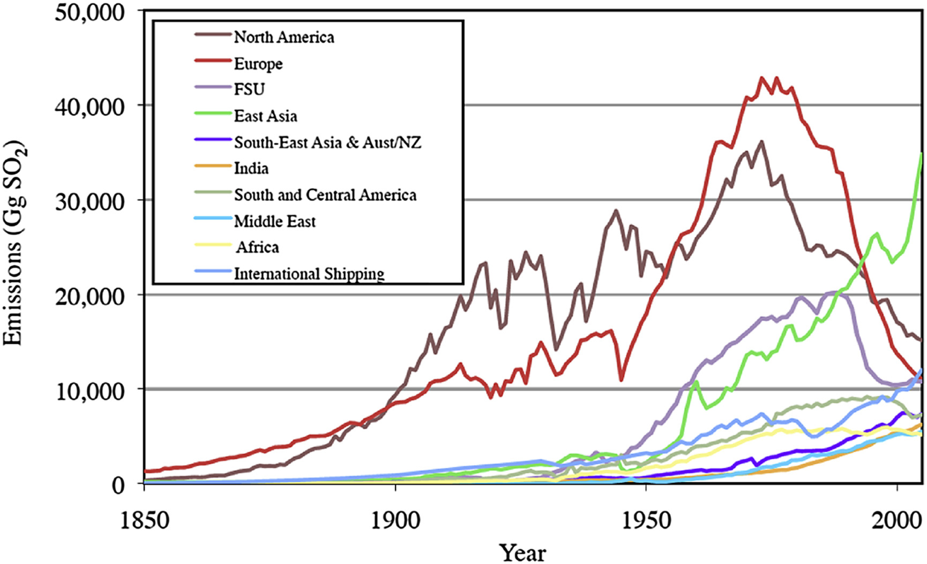
Acid Rain Policy -2
In Europe, acid deposition is falling

Slide 44
Acid Rain Policy -2
In Europe, acid deposition is falling
Why? It is a public good!
Vehicles also contributed to urban air pollution
Power plants typically operated by semi-governments
There was strong public demand, and a not excessively expensive technical fix
Coal, the dirtiest fuel, was becoming less and less competitive
Eastern European industry collapsed

Slide 45
Ozone Policy
CFCs, used as refrigerants, solvants, propellants, destroy stratospheric ozone that keeps out carcinogenic UV radiation
Vienna, 1985: Threat recognised; agreement on information sharing and scientific cooperation
Montreal, 1988: 24 mainly OECD countries agree to phase out production and consumption of CFCs; 5 amendments that accelerate phase out and add new countries
Jan 2001: Consumption and production of CFCs is forbidden in the OECD and in most developing countries

Slide 46
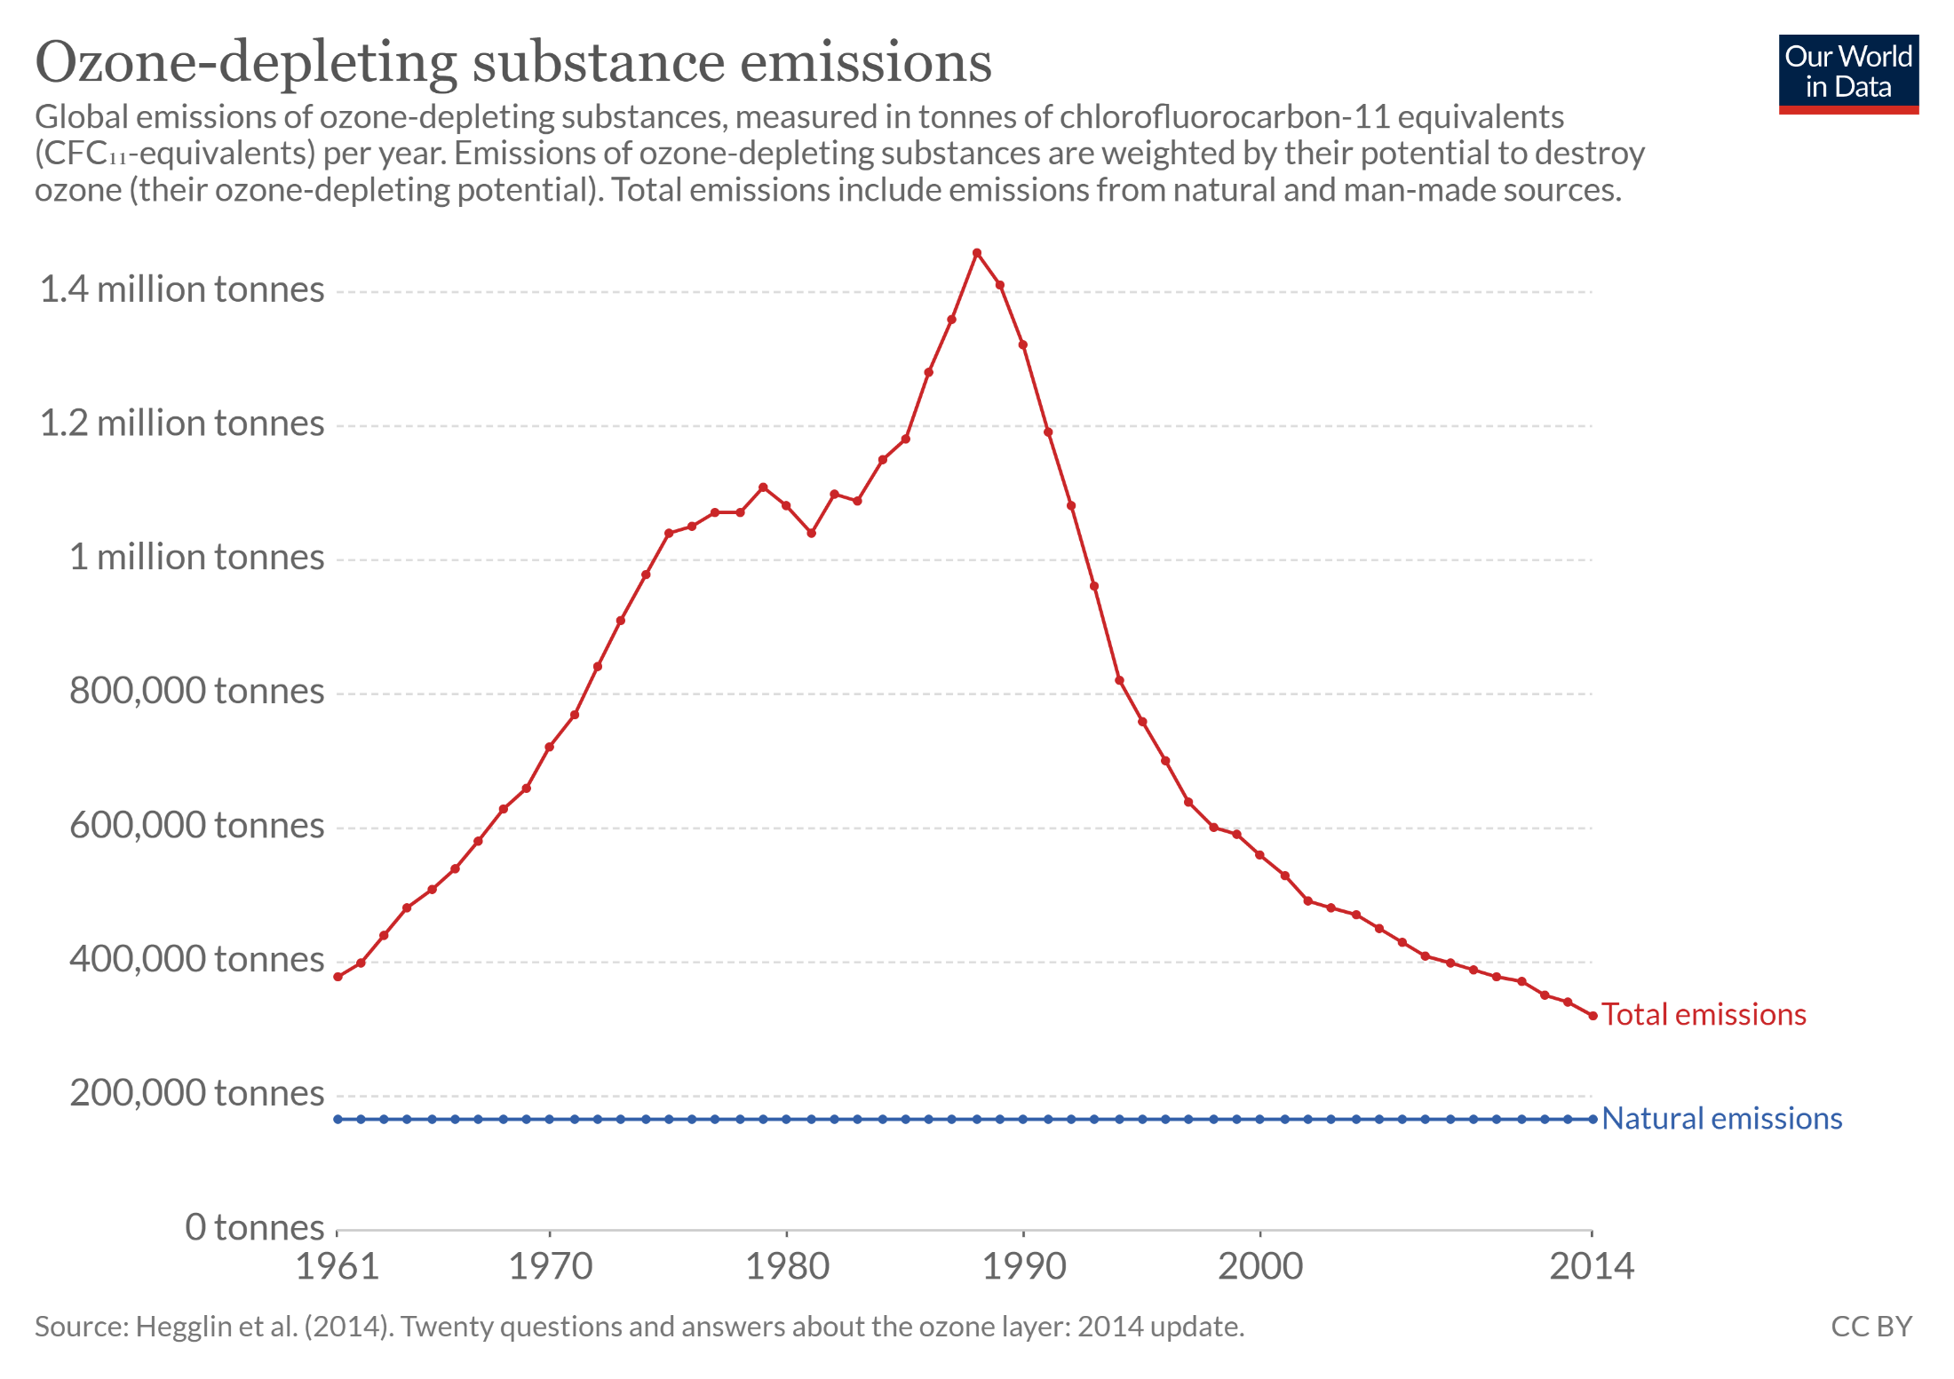

Slide 47
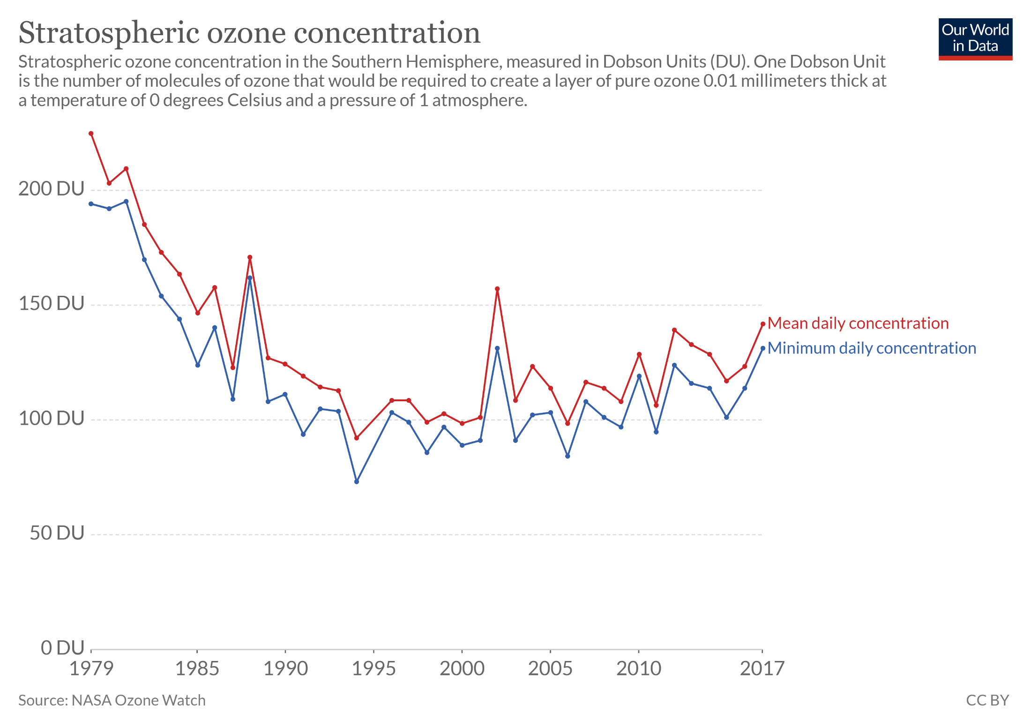

Slide 48

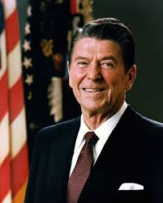
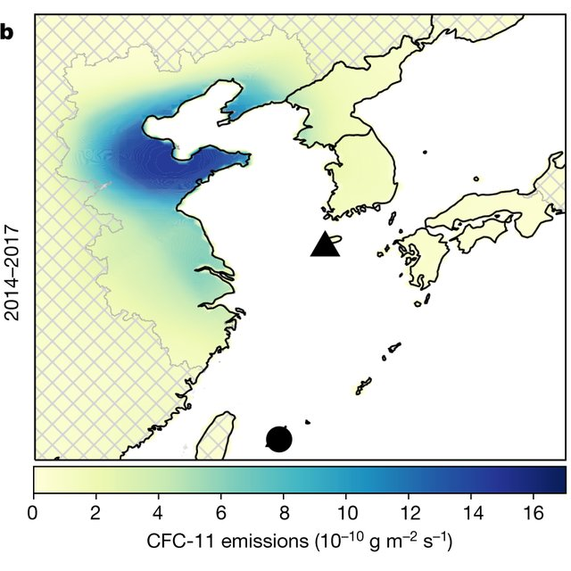
Ozone Policy -2
Why this success?
Global public good
Strong public demand
Availability of a cheap, technological fix
DuPont brokered the deal at Montreal
Developing countries bribed with money, technology, WTO access
Illegal trade and waste remain a problem
Trade sanctions

Slide 49
Ozone Policy -3
Montreal Protocol bans the export of CFCs
CFCs are not difficult to make, but substantial economies of scale
For countries without a domestic supply of CFCs, the choice is between
restricted supply of CFCs for a low price + unlimited supply of HFCs for a medium price
unlimited supply of CFCs at a high price
This induced a lot of small countries to sign-up
China and India got bribes: WTO and technology

Slide 50
Ozone Policy -4
Exporters of CFCs also happen to export its substitutes, choice is between
an unrestricted low-value market
a restricted low-value market plus a high-value growth market
Domestic pressure for emission reduction
HFCs replaced CFCs: No damage to ozone, but stronger greenhouse gases

Slide 51
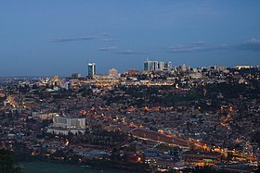
Ozone Policy -4
HFCs replaced CFCs: No damage to ozone, but stronger greenhouse gases
Ozone regulations are now used to phase out HFCs

Slide 52
Lessons for climate
Emissions of acidifying gases and ozone-destroying gases have been reduced, even though this is an international public good
Strong public demand
Cheap alternative
Acid rain: Emissions cut for other reasons
Ozone hole: Alternative from same supplier
Public demand apart, these characteristics do not carry over to climate change

